Slide 1
Business Recommendations
An analysis report showcasing insights and business perks.

Slide 2
Introduction
This presentation will cover the key insights derived from the analysis report and highlight the potential business advantages.

Slide 3
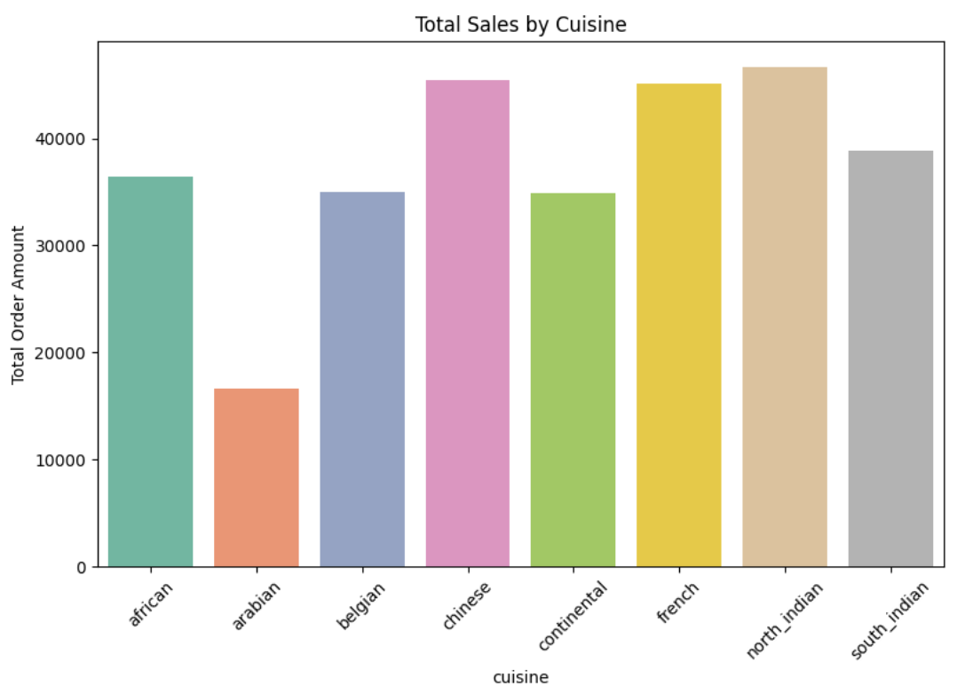
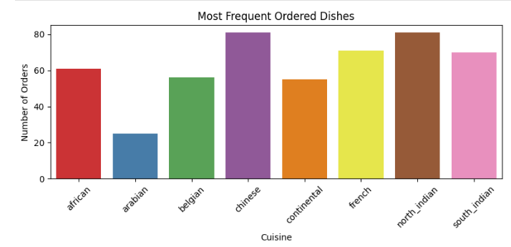
Sales Analysis
North Indian cuisine has the highest order volume, followed by Chinese and French. - Promote North Indian and Chinese cuisines through targeted offers. - South Indian cuisine is performing well; consider boosting it with promotional deals. - French cuisine is perceived as premium; adjusting its pricing may drive more orders.

Slide 4
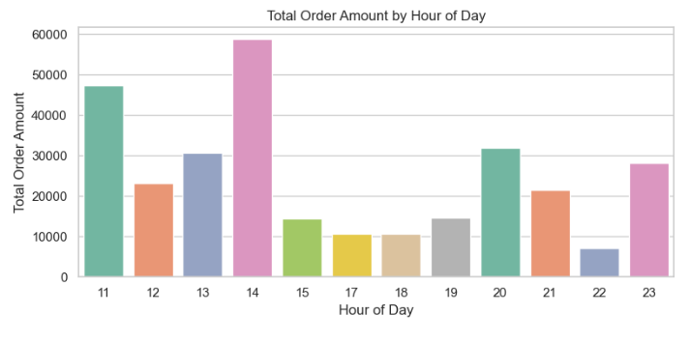
Hour Sales Analysis
Peak order times are 11 AM, 2 PM, and 8 PM, indicating lunch and early dinner rush hours.
Allocate resources accordingly to optimize kitchen and delivery operations during these peak periods.

Slide 5
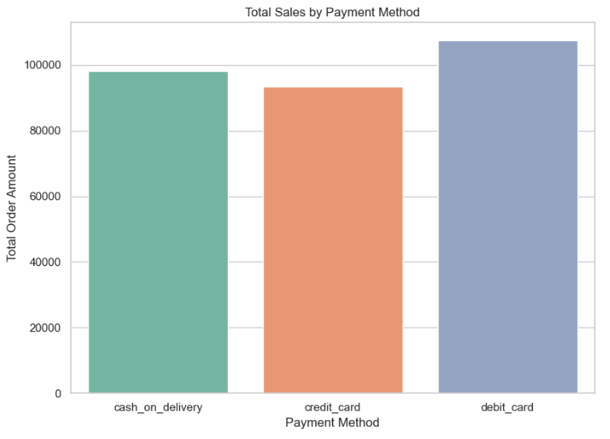
Payment Method Used
Debit card is the most preferred payment method among customers.
Introduce targeted offers or cashback for debit card payments to increase retention and transaction volume.

Slide 6
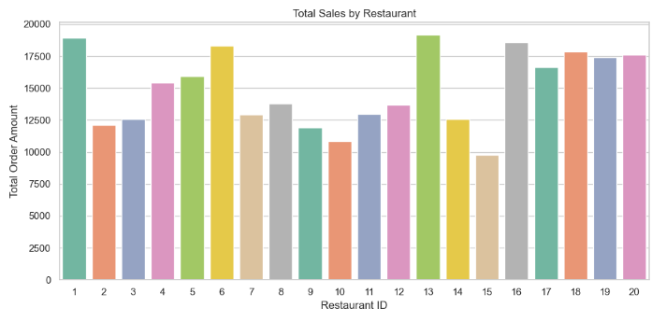
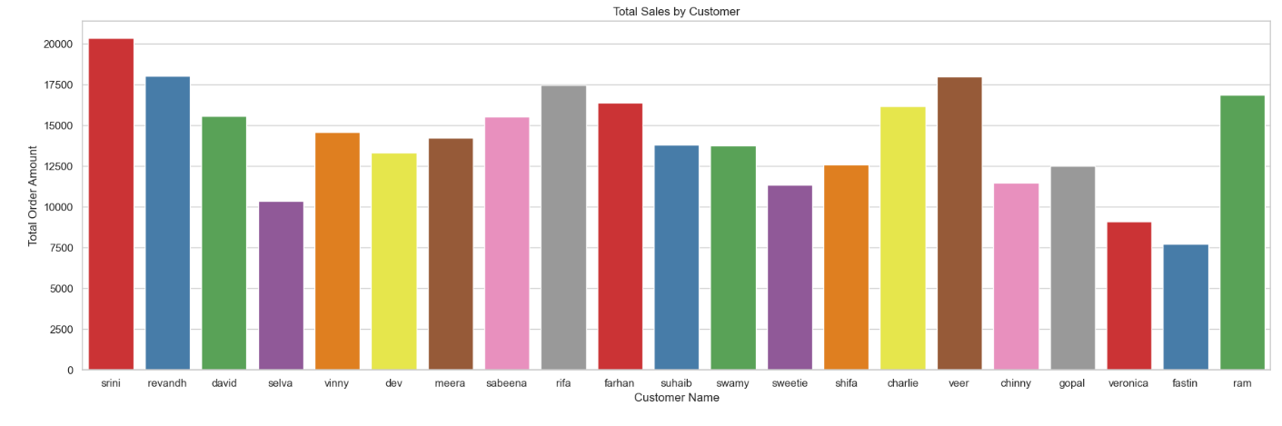
Top Restaurants and Customers
Promoting Restaurants like 18,19 and 20 will scale the revenue as well
Different discounts should be offered on different cuisines
Restaurants 1 and 13 receive the highest customer engagement.
Support them with exclusive promotional campaigns to increase loyalty.
Frequent customers such as Srini and Veer could be rewarded with loyalty offers or personalized discounts.

Slide 7
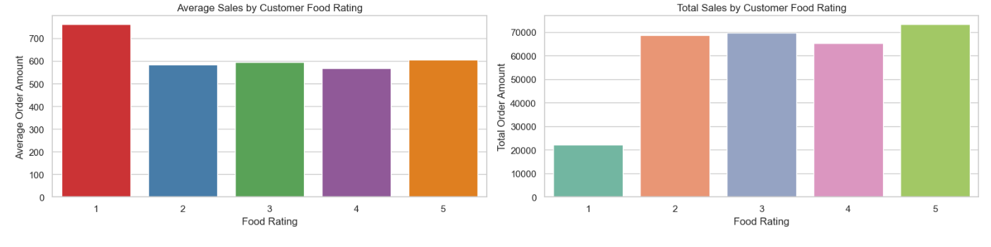
Sales Analysis By Rating
Customers often rate a cuisine poorly (1 star) and switch to another in subsequent orders.
Promote high-rated cuisines (4–5 stars).
Investigate 3-star cuisines for quality improvements.
Identify and resolve issues causing 1-star ratings; consider removing underperforming dishes.

Slide 8
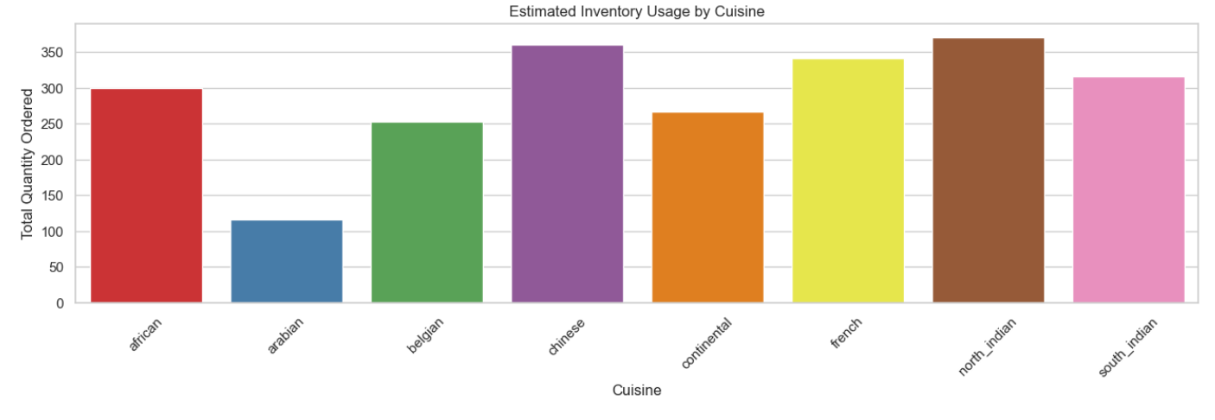
Recommendations on Inventory Usage
North Indian and Chinese cuisine-based restaurants receive more orders.
Ensure adequate stock of ingredients specific to these cuisines to avoid shortages during peak hours.

Slide 9
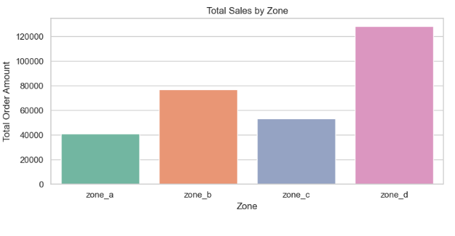
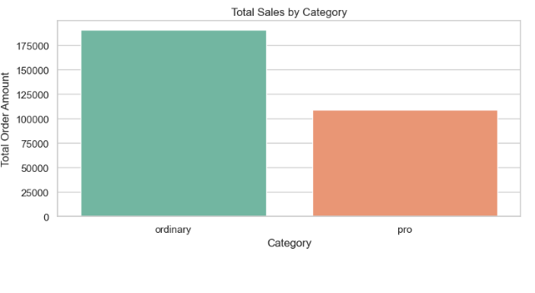
Recommendations on different zones and categories
Zone D has the highest order volume; focus on optimizing delivery services in this area.
Ordinary category restaurants are more popular—possibly due to high pricing of pro-level restaurants.
Zone A has lower order volume; evaluate delivery times and consider targeted promotions to boost demand.

Slide 10
Final Recommendations
Sales Optimization and Customer Engagement
Promote top cuisines: North Indian, Chinese, and French generate the most revenue. Action: Highlight them in promotions, home page banners, and combo offers.
Increase Average Order Value (AOV): Bundling items or suggesting add-ons can drive higher revenue. Action: Implement upselling strategies (e.g., drinks, sides) during checkout.
Retain high-value customers: A small group of customers contributes a large share of revenue. Action: Launch loyalty programs or personalized offers for repeat buyers.

Slide 11
Final Recommendations
Delivery Optimization and Inventory Planning
Improve delivery times: Faster deliveries lead to better ratings. Action: Optimize rider allocation during peak hours (especially 6–11 PM).
Plan based on demand forecasting: Forecasting models predict dinner demand using lunch data. Action: Use predictions to schedule staff and prep inventory accordingly.
Stock based on cuisine demand: North Indian and Chinese cuisine require high inventory turnover. Action: Ensure ingredient stock meets forecasted demand.

Slide 12
Final Recommendations
Zone Strategy & Quality Focus
Zone-specific promotions: Zone D has high order volume; Zone A underperforms. Action: Improve delivery service in Zone D, analyze bottlenecks in Zone A.
Work on underperforming cuisines: Some cuisines (e.g., Belgian, Chinese delivery) have lower ratings. Action: Investigate quality issues and retrain kitchens if needed.
Time-based dish targeting: Dishes vary in popularity by hour. Action: Adjust menu recommendations based on time-of-day trends.

Slide 13
THANK YOU !
BY - Akash Tripathi

